Slide 1
Cornerstone City Church Peninsula Plus Community Hoo Are Ya
19th October 2025

Slide 2
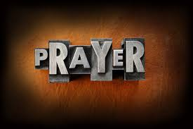

Slide 3
Mighty Name Of Jesus
CCLI Song # 7244496
Hope Darst | Jacob Sooter | Lauren Sloat
© 2024 Fair Trade Global Songs; Hope For The Best Songs; TBCO Publishing; Just When Publishing; So Essential Tunes; Remaining portion is unaffiliated
For use solely with the SongSelect® Terms of Use. All rights reserved. www.ccli.com
CCLI Licence No. 33265

Slide 4
1/9
I pray into the atmosphere
Spirit of God You're here
You have all authority
I pray over my heart and mind
I am healed by Your stripes
Your blood declares that I am free

Slide 5
2/9
In the mighty name of Jesus I pray
Calling on the power of heaven I proclaim
Every weapon formed against me must break
In the mighty name of Jesus

Slide 6
3/9
I draw a permanent boundary line
The enemy has no rights
To come near my family
No scheme could ever undo God's plans
No matter the circumstance
The cross has sealed my destiny

Slide 7
4/9
In the mighty name of Jesus, I pray
Calling on the power of heaven I proclaim
Every weapon formed against me must break
In the mighty name of Jesus

Slide 8
5/9
In the mighty name of Jesus, I know
All the power of fear and darkness must go
'Cause every key to every victory I hold
In the mighty name of Jesus

Slide 9
6/9
I will not fear I will not fear
When the enemy comes near
On the doorframe of my life
Is the blood of Jesus Christ

Slide 10
7/9
I will not fear I will not fear
There's an army of angels here
I'm protected on all sides
By the blood of Jesus Christ

Slide 11
8/9
In the mighty name of Jesus, I pray
Calling on the power of heaven I proclaim
Every weapon formed against me must break
In the mighty name of Jesus

Slide 12
9/9
In the mighty name of Jesus, I know
All the power of fear and darkness must go
'Cause every key to every victory I hold
In the mighty name of Jesus
In the mighty name of Jesus

Slide 13
Shout To The Lord
CCLI Song # 1406918
Darlene Zschech
© 1993 Wondrous Worship (Admin. by Song Solutions www.songsolutions.org)
For use solely with the SongSelect® Terms of Use. All rights reserved. www.ccli.com
CCLI Licence No. 33265

Slide 14
1/3
My Jesus my Saviour
Lord there is none like You
All of my days I want to praise
The wonders of Your mighty love
My comfort my shelter
Tower of refuge and strength
Let every breath all that I am
Never cease to worship You

Slide 15
2/3
Shout to the Lord
All the earth let us sing
Power and majesty
Praise to the King
Mountains bow down
And the seas will roar
At the sound of Your name

Slide 16
3/3
I sing for joy
At the work of Your hands
Forever I'll love You
Forever I'll stand
Nothing compares to the promise
I have in You

Slide 18
This Is Amazing Grace
CCLI Song # 6333821
Jeremy Riddle | Josh Farro | Phil Wickham
© 2012 WC Music Corp. (Admin. by / Small Stone Media BV, Holland (Admin. in the UK/Eire by Song Solutions www.songsolutions.org))
Bethel Music Publishing (Admin. by Song Solutions)
Phil Wickham Music (Admin. by Song Solutions www.songsolutions.org)
Seems Like Music (Admin. by Song Solutions www.songsolutions.org)
Sing My Songs (Admin. by Song Solutions www.songsolutions.org)
For use solely with the SongSelect® Terms of Use. All rights reserved. www.ccli.com
CCLI Licence No. 33265

Slide 19
1/8
Who breaks the power of sin and darkness
Whose love is mighty and so much stronger
The King of Glory the King above all kings

Slide 20
2/8
Who shakes the whole earth with holy thunder
And leaves us breathless in awe and wonder
The King of Glory the King above all kings

Slide 21
3/8
This is amazing grace
This is unfailing love
That You would take my place
That You would bear my cross
You laid down Your life
That I would be set free
Oh Jesus I sing for all that You've done for me

Slide 22
4/8
Who brings our chaos back into order
Who makes the orphan a son and daughter
The King of Glory the King of Glory

Slide 23
5/8
Who rules the nations with truth and justice
Shines like the sun in all of its brilliance
The King of Glory the King above all kings

Slide 24
6/8
This is amazing grace
This is unfailing love
That You would take my place
That You would bear my cross
You laid down Your life
That I would be set free
Oh Jesus I sing for all that You've done for me

Slide 25
7/8
Worthy is the Lamb who was slain
Worthy is the King who conquered the grave
Worthy is the Lamb who was slain
Worthy is the King who conquered the grave
Worthy is the Lamb who was slain
Worthy is the King who conquered the grave
Worthy is the Lamb who was slain
Worthy worthy worthy

Slide 26
8/8
This is amazing grace
This is unfailing love
That You would take my place
That You would bear my cross
You laid down Your life
That I would be set free
Oh Jesus I sing for all that You've done for me

Slide 27
Holy Forever
CCLI Song # 7201044
Brian Johnson | Chris Tomlin | Jason Ingram | Jenn Johnson | Phil Wickham
© Phil Wickham Music (Admin. by / Small Stone Media BV, Holland (Admin. in the UK/Eire by Song Solutions www.songsolutions.org))
Simply Global Songs (Admin. by / Small Stone Media BV, Holland (Admin. in the UK/Eire by Song Solutions www.songsolutions.org))
Capitol CMG Paragon (Admin. by Capitol CMG Publishing)
S. D. G. Publishing (Admin. by Capitol CMG Publishing)
Be Essential Songs (Admin. by Essential Music Publishing LLC)
My Magnolia Music (Admin. by Essential Music Publishing LLC)
Bethel Music Publishing (Admin. by Song Solutions)
Brian and Jenn Publishing (Admin. by Song Solutions)
For use solely with the SongSelect® Terms of Use. All rights reserved. www.ccli.com
CCLI Licence No. 33265

Slide 28
1/10
A thousand generations falling down in worship
To sing the song of ages to the Lamb
And all who've gone before us
And all who will believe
Will sing the song of ages to the Lamb

Slide 29
2/10
(Jesus) Your name is the highest
Your name is the greatest
Your name stands above them all
All thrones and dominions
All powers and positions
Your name stands above them all

Slide 30
3/10
And the angels cry Holy
All creation cries Holy
You are lifted high Holy
Holy forever

Slide 31
4/10
If you've been forgiven and if you've been redeemed
Sing the song forever to the Lamb
If you walk in freedom and if you bear His name
Sing the song forever to the Lamb
We'll sing the song forever and amen

Slide 32
5/10
And the angels cry Holy
All creation cries Holy
You are lifted high Holy
Holy forever

Slide 33
6/10
Hear Your people sing Holy
To the King of Kings Holy
You will always be Holy
Holy forever

Slide 34
7/10
(Jesus) Your name is the highest
Your name is the greatest
Your name stands above them all
All thrones and dominions
All powers and positions
Your name stands above them all

Slide 35
8/10
And the angels cry Holy
All creation cries Holy
You are lifted high Holy
Holy forever

Slide 36
9/10
Hear Your people sing Holy
To the King of Kings Holy
You will always be Holy
Holy forever

Slide 37
10/10
You will always be Holy
Holy forever

Slide 39


Slide 40
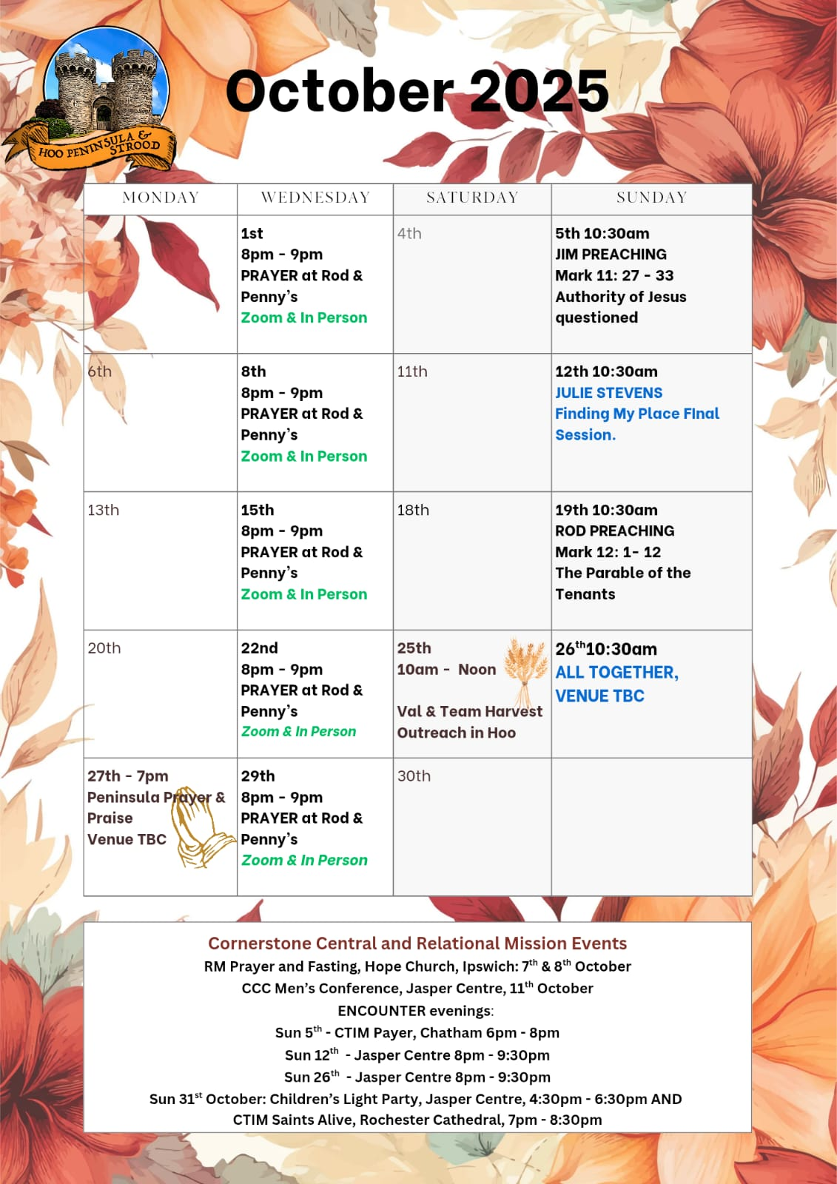

Slide 41
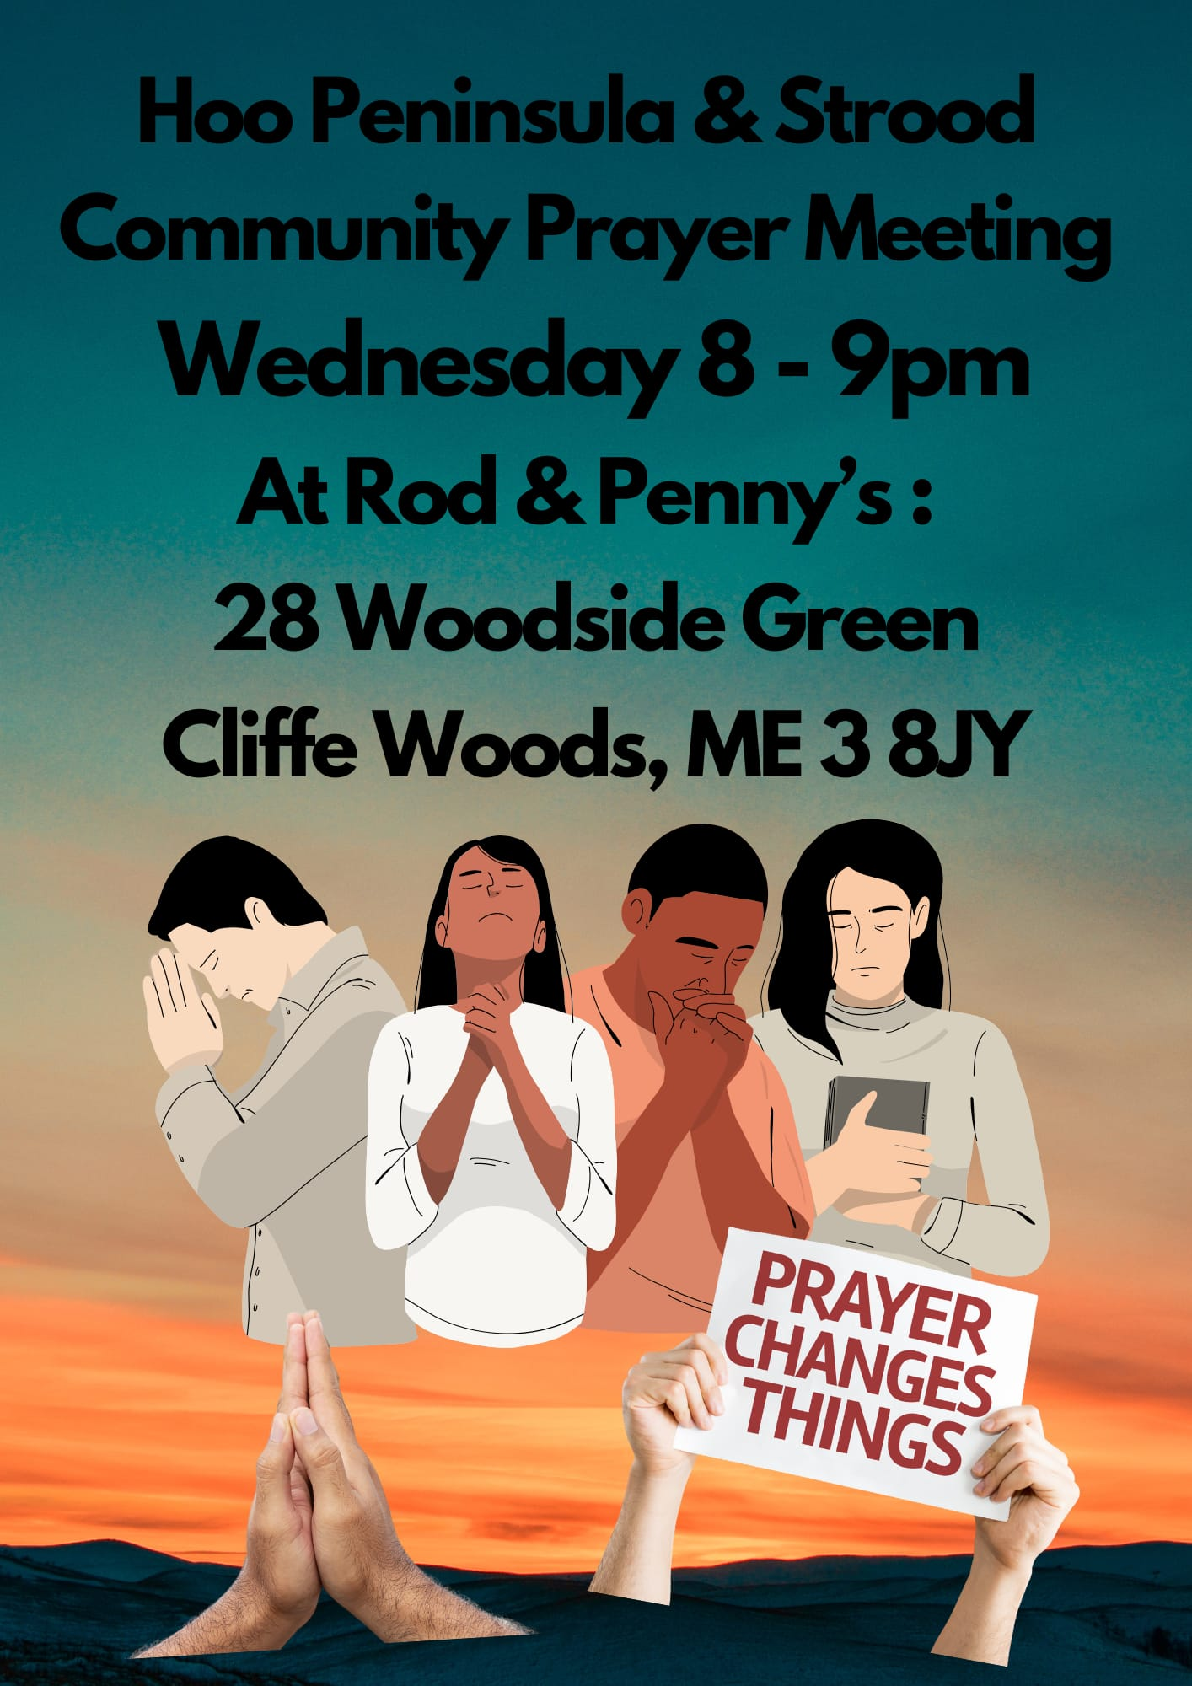

Slide 42
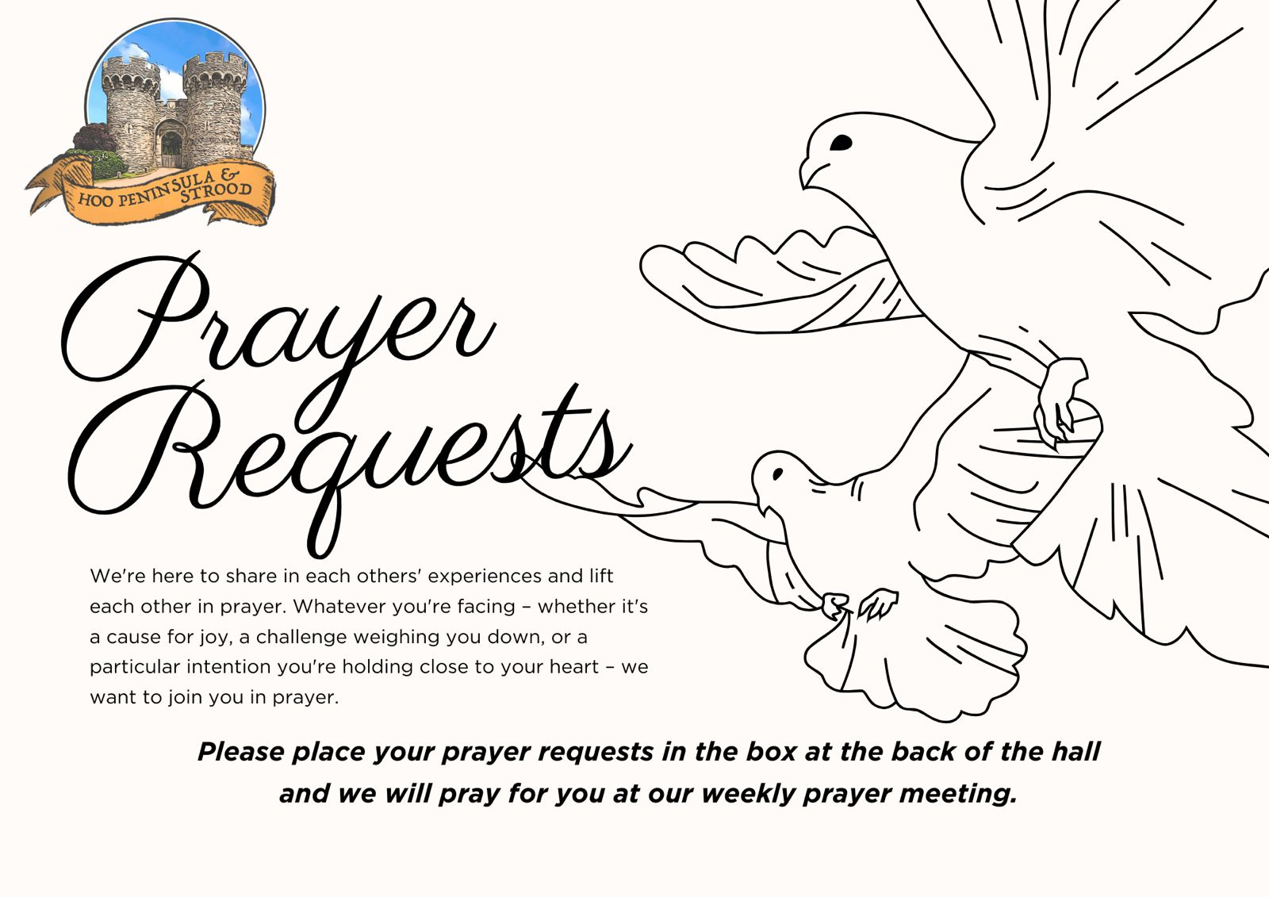

Slide 43

Grow Group 1
On YOUR MARK!

Slide 44
Leaders
Leaderss
Phil & Kim
Maria (Mia) Warren
Matthew Harrison
Richard & Elisha Acheampong
Phil & Kim
Maria (Mia) Warren
Matthew Harrison
Richard & Elisa Acheampong

Slide 45

Leaders
Phil & Kim
Maria (Mia) Warren
Matthew Harrison
Richard & Elisa Acheampong

Slide 46

Storm Walker
Storm Walker
Symbolising, trust in Jesus Christ through life's storms.
Mark 4:35-41

Slide 47



Group Leaders
Micheal and Mwamba
Wilfred and Parveen
Hannah

Slide 48


Slide 49
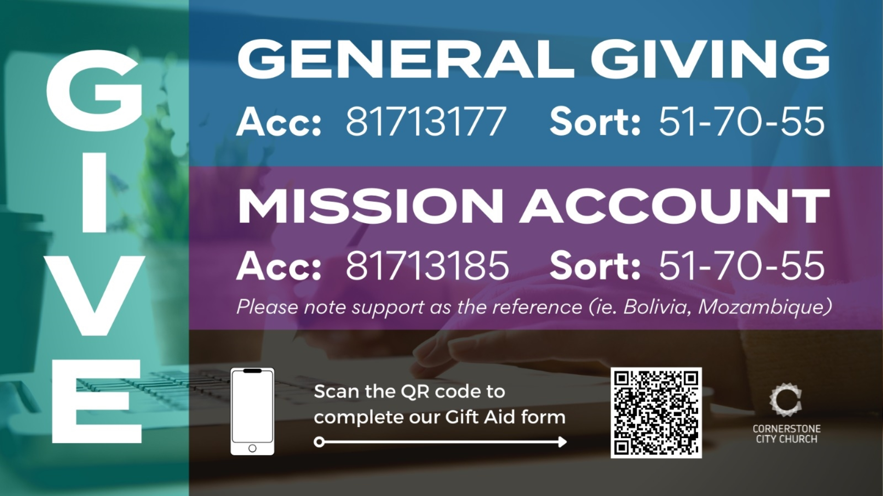

Slide 50


Slide 51
2 Corinthians 14 May the grace of the Lord Jesus Christ, and the love of God, and the fellowship of the Holy Spirit be with you all
Surely goodness and mercy shall follow us all the days of our lives, and we shall dwell in the house of the Lord forever.

